Slide 1
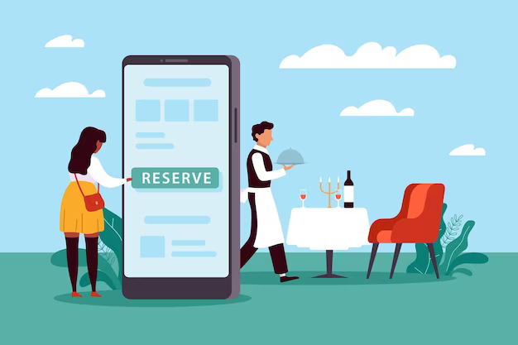
Group
1
REAL LIFE LAB (RLL) PROJECT
Project:
Cafe Table Reservation System
Presented By :
1. Abishek S (2580667)
2. Ajay Sahu (2580287)
3. Aswathy P K (2579379)
4. B Harish Reddy (2580097)
5. Basavaraj Ainapure (2579359)
6. Bathini Kavya (2580285)
7. Bhumika R (2580388)
8. Borra Madhuri Devi (2580234)

Slide 2
CONTENTS
Title
Contents
Modules
Objective
Introduction
Database Schema
Admin and User Components
Software Requirements
Cafe Table Reservation Website
Testing Reports
Conclusion
Thank You

Slide 3
Modules
Name | Domain | Modules
1. Abishek S (Team Lead) | FSD Admin/User | Admin Login, Table Reservation & Reservation Confirmation
2. Ajay Sahu | FSD User | Specail Items, Gallery & Update Profile
3. Aswathy P K | FSD Admin | Admin Add Menu Module, Admin Logout & Admin Dashboard
4. B Harish Reddy (Backend Lead) | FSD Admin/User | Menu Module edit, Update & Delete
5. Basavaraj Ainapure | FSD User | Menu Search Key Module ,Contact Us, About Us
6. Bathini Kavya | FSD User | User Register & User Login
7. Bhumika R (Frontend Lead) | FSD User | User Search Table Module & User Logout
8. Borra Madhuri Devi | FSD Admin/User | Add Table Module, User Dashboard

Slide 4

Objective
Comfortable for Users
User-Friendly
Flexible
Customer Engagement

Slide 5
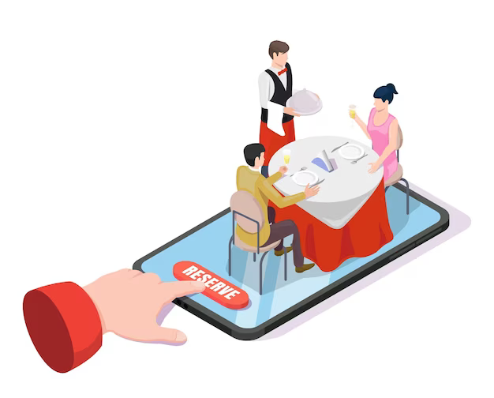
Introduction
Cafe reservation System has two parts
Admin
User
The Admin Section is like the control hub of our cafe reservation, giving owners the tools to oversee everything.
Users can create personalized accounts, conveniently manage reservations, and explore the cafe's menu with detailed descriptions and pricing.

Slide 6
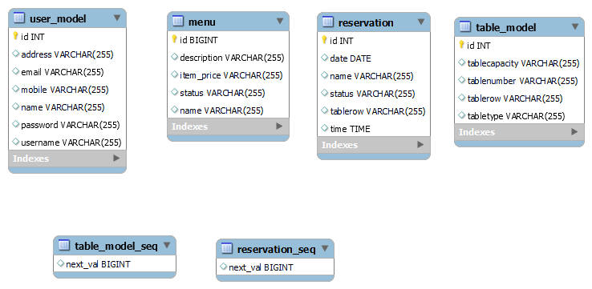
DATABASE SCHEMA

Slide 7
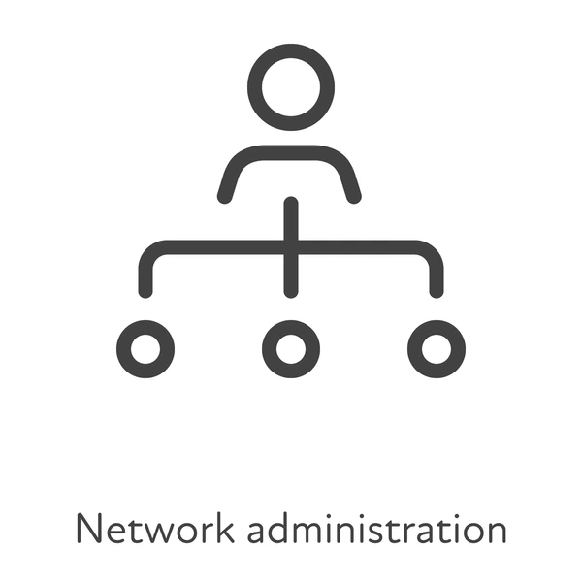
Admin and User Components

Slide 8
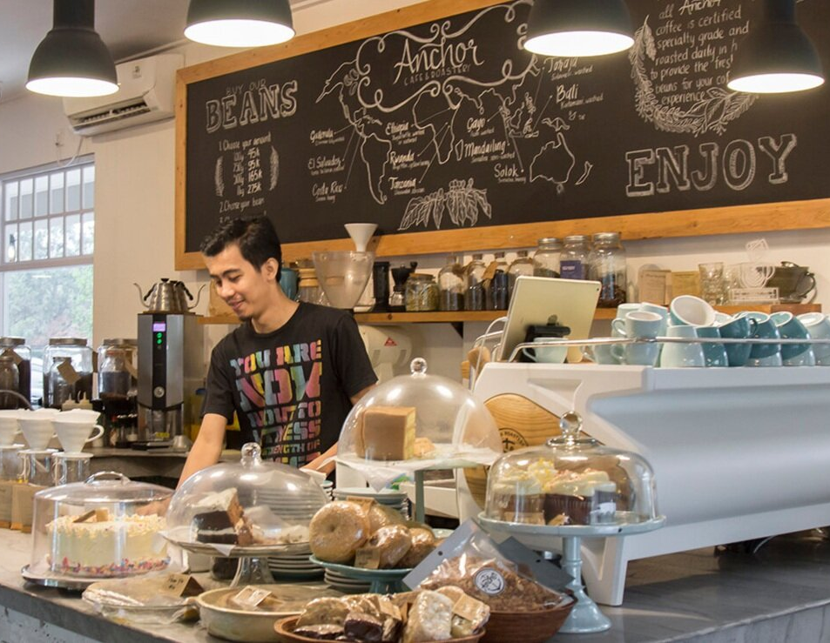
Admin Components
Admin Login Module
Admin Dashboard
Menu Module(CRUD)
Table Module
Reservation Module

Slide 9
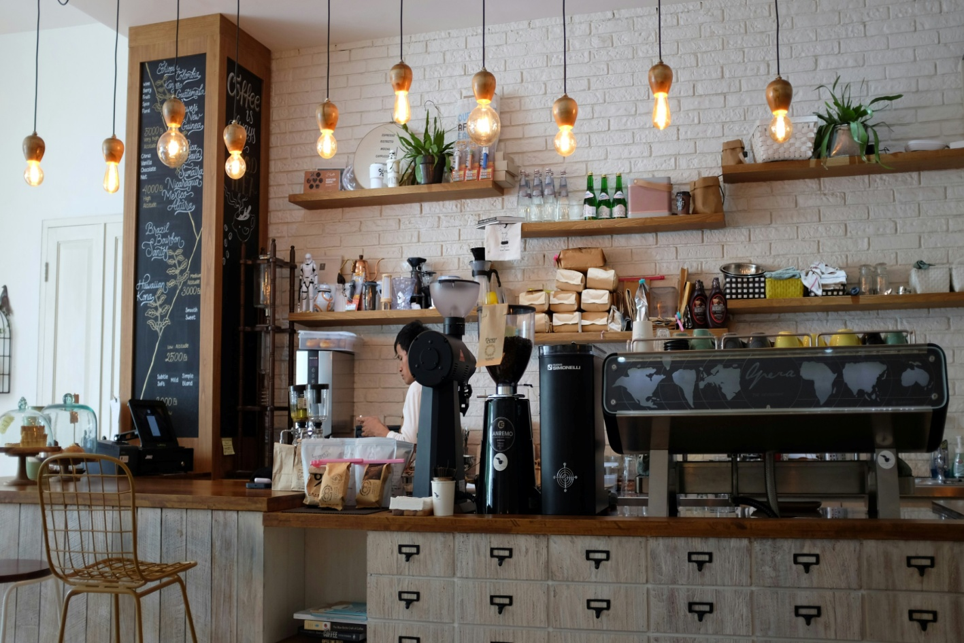
User Components
User Login Module
User Dashboard
About Us
Menu module
Special Item
Search table Module
Reservation Module
Update profile
Gallery
Contact Us

Slide 10





Software Requirements
Spring Tool
Visual Studio Code
MySQL Workbench
Testing: Postman, TestNG

Slide 11
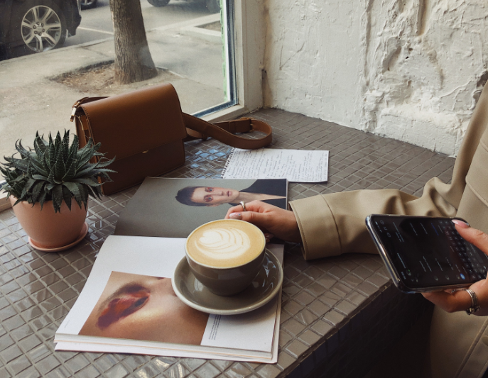
Outcome
Attract New Customers
Enhanced Customer Experience
Maximum Table Turnover
Improved Operational Efficiency

Slide 12
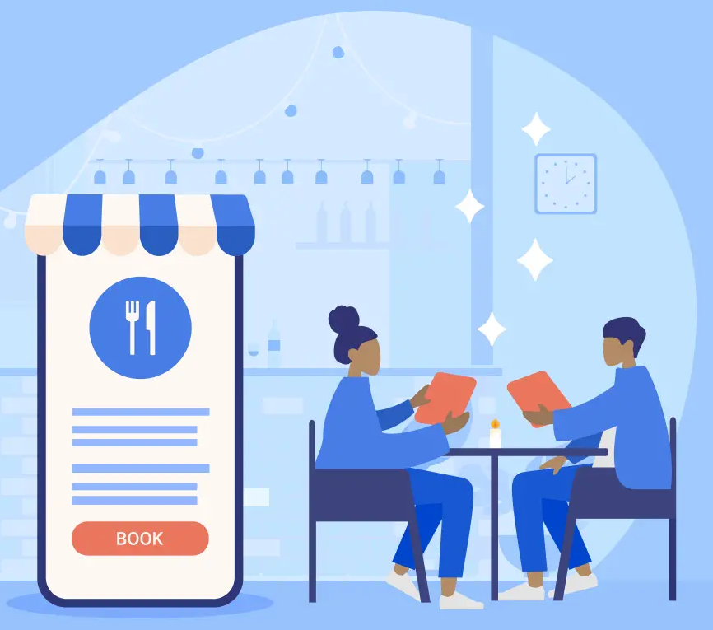
Cafe Table Reservation Website

Slide 13
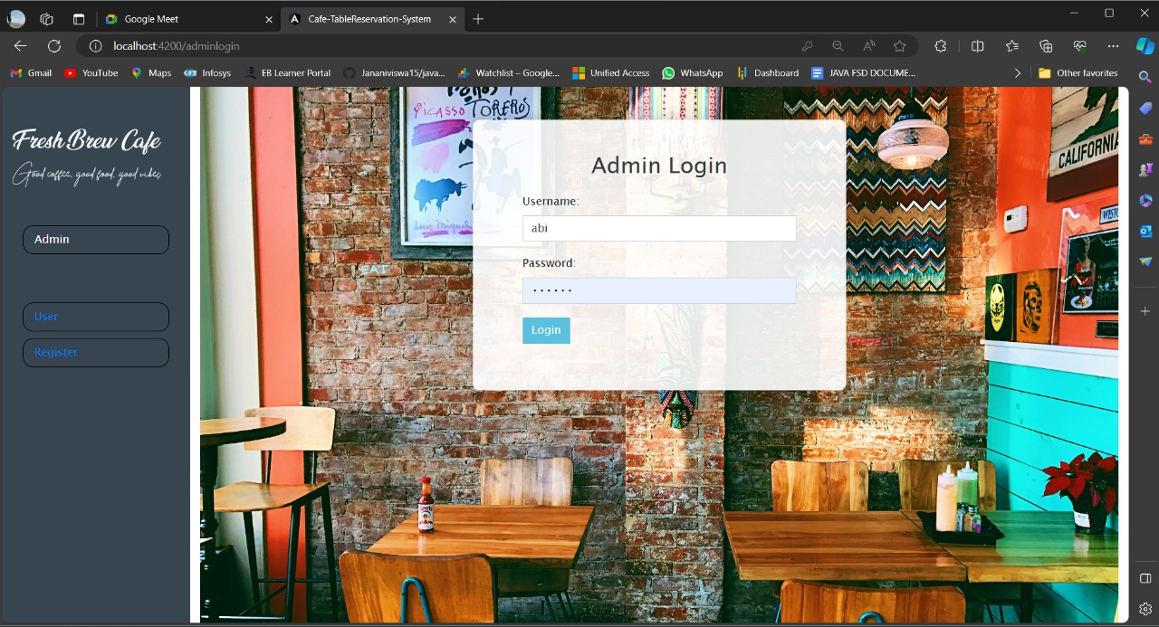
Admin Login
Admin login is to validate admin credentials.
If credentials are matched, it will redirect to Admin dashboard
If we enter wrong credentials system will give message invalid credentials.

Slide 14
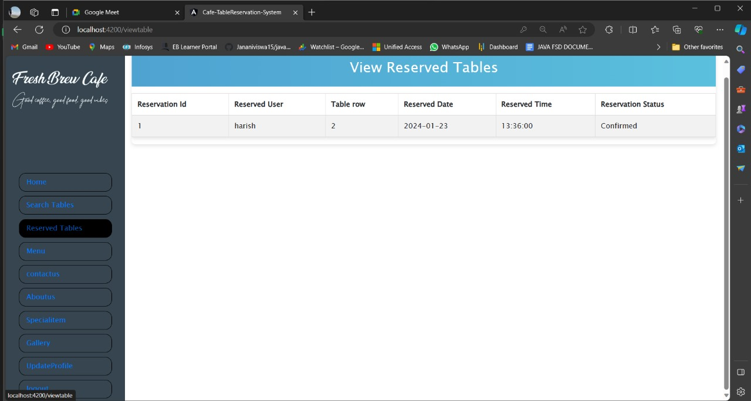
Reserved Tables
User Module where user can login and reserve a table with their appropriate date and time.
In search tables modules of user login, we have the option to search and reserve.
Based on id, date and time it will be post and the default status will be in pending.

Slide 15
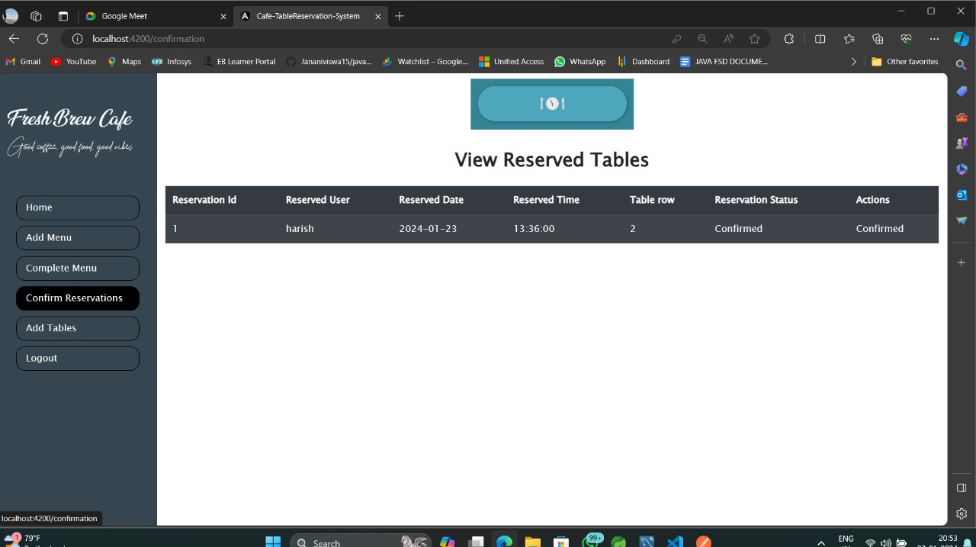
Confirm Reservation
Admin Module where admin can login and Approve table request.
In confirm reservation module of admin login ,we have the list of reservations made by all users.
Default status of each reservation will be pending, once approved status will be turned to confirm.

Slide 16
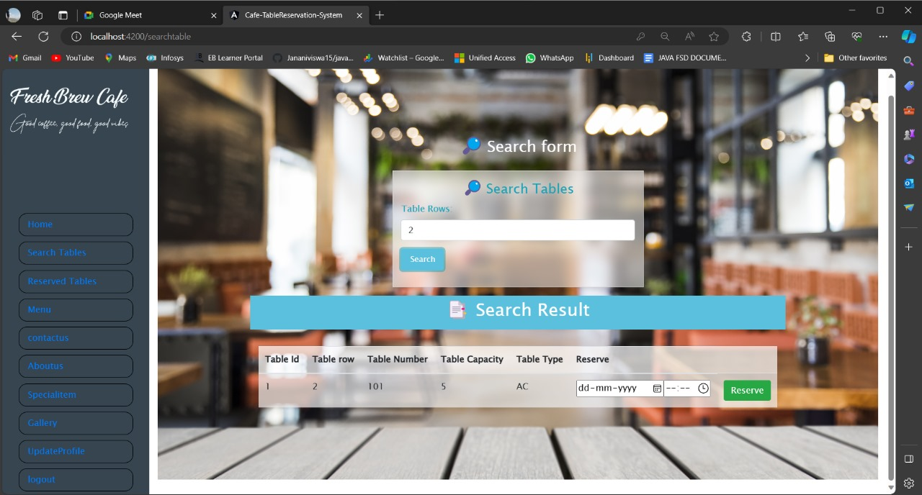
Search Tables And Book
Search Table helps the user to search for a particular table and the results related to the search record is display.
The User can choose the table type, table capacity and also reserve table for particular date and time.

Slide 17
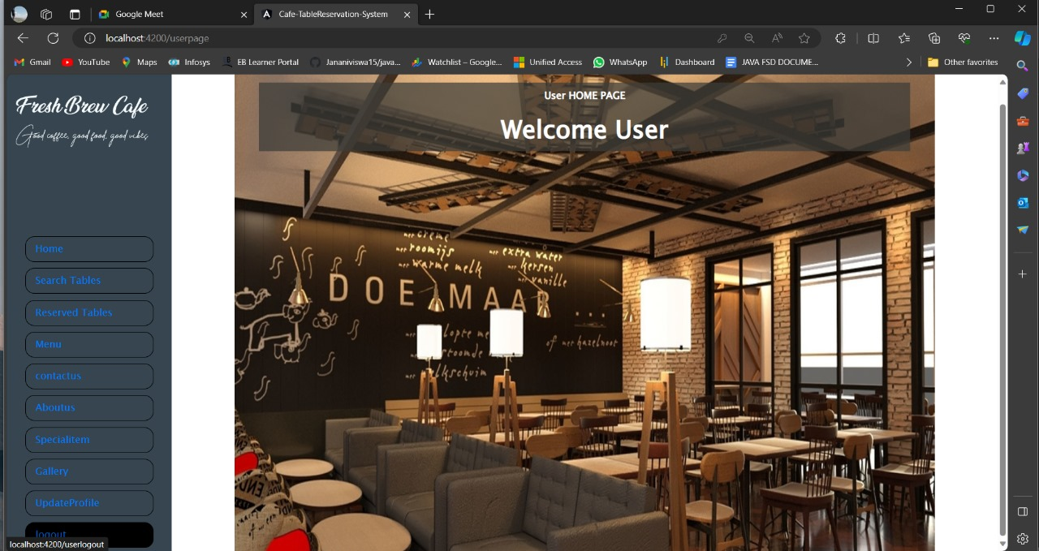
User Logout
Logout is used to sign out from the user account and navigate back to user login page

Slide 18
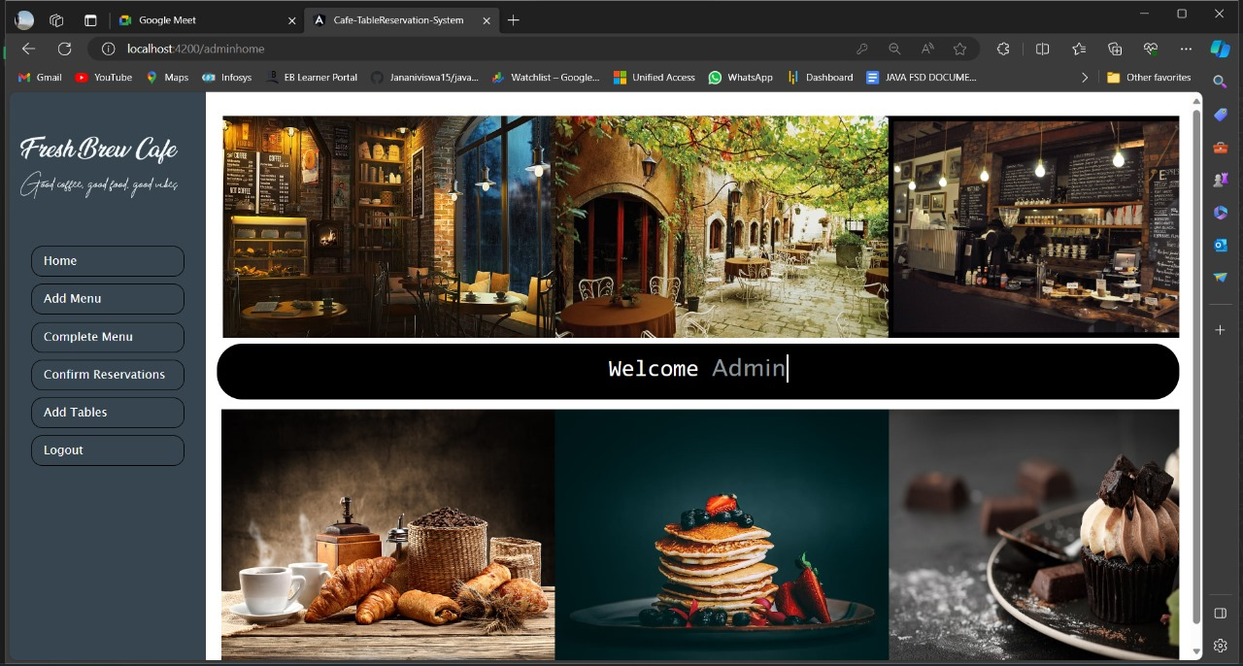
Admin Homepage
On successful admin login, redirected to admin homepage.
Displays navigation bar components on left.

Slide 19
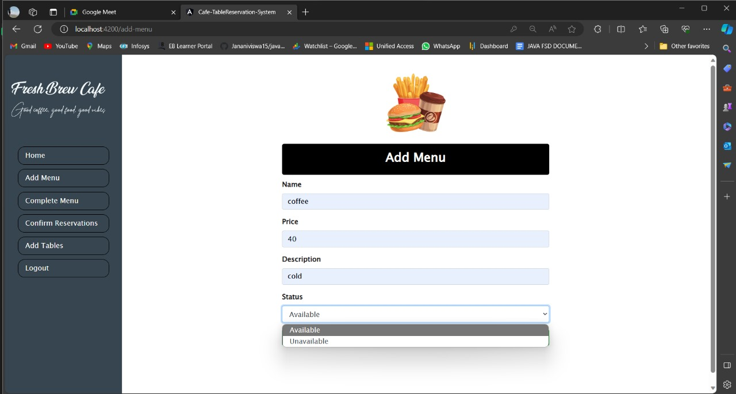
Add Menu Item
To add new food items to the existing menu.
Add menu form is used to enter details of the food item and save to menu.

Slide 20
Logout Admin
Logout is used to sign out from the admin account and navigate back to admin login page.

Slide 21
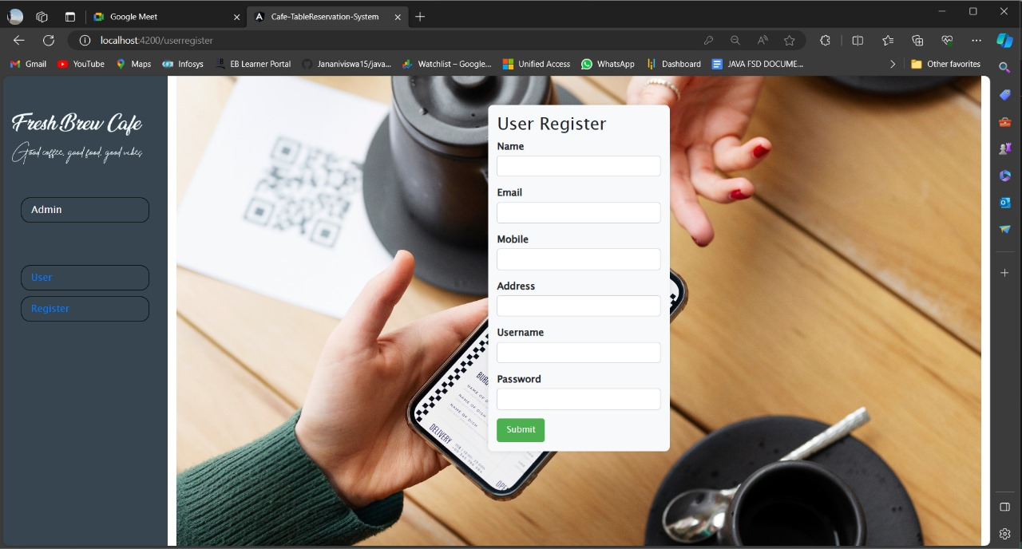
User Register
.User Register refers to the process where individuals sign up or create accounts on websites, platforms, or applications by providing necessary information such as username password mobile number
. Registered users normally provide some sort of credentials (such as username e-mail address and password) to the system in order to prove their identity this is known as logging in.

Slide 22
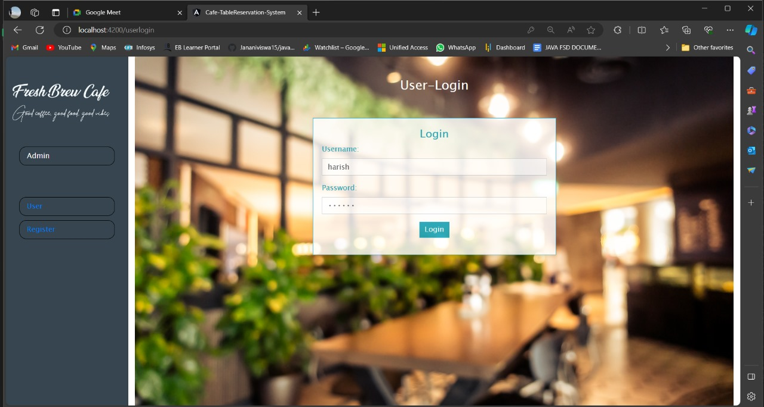
User Login
. User login is essential for securing
User accounts and ensuring that only authorized
Individuals can access specific resources or
information
. User login means a login and password that allows
access To the service

Slide 23
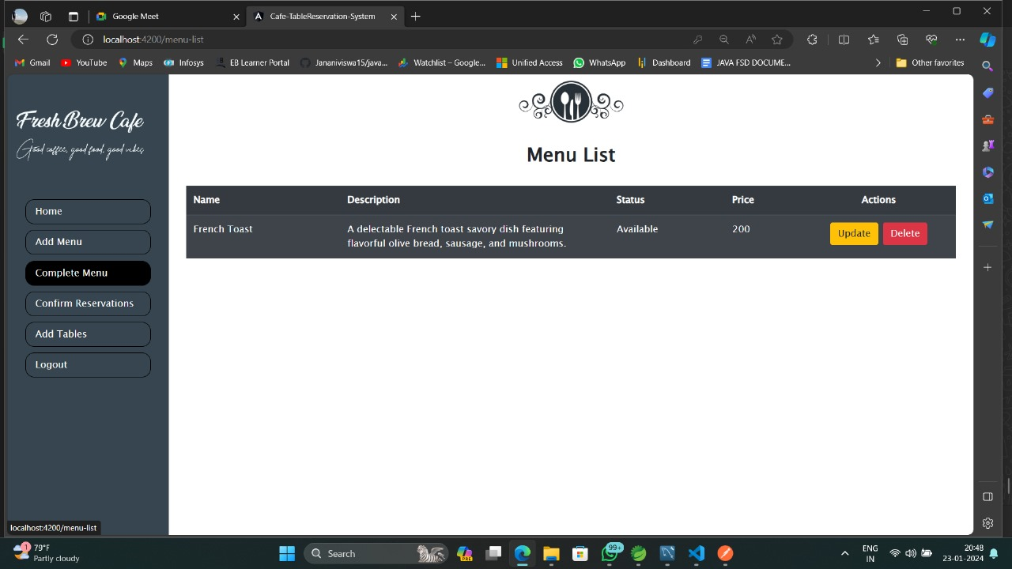
Menu List
Displays a list of menu items in a table also manages to display the updating, and deleting of menu items.
Error handling is implemented using RxJS operators

Slide 24
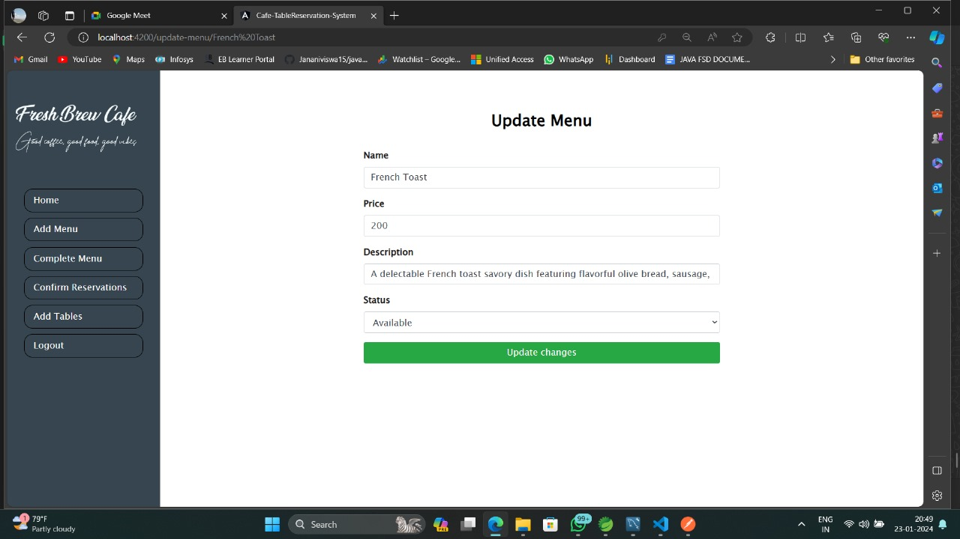
Update Menu Item
Form includes fields for Name, Price, Description, and Status
Bootstrap for styling and Angular for form handling
retrieves the menu details based on the provided name
The page displays a success message alert when the form is successfully submitted.

Slide 25
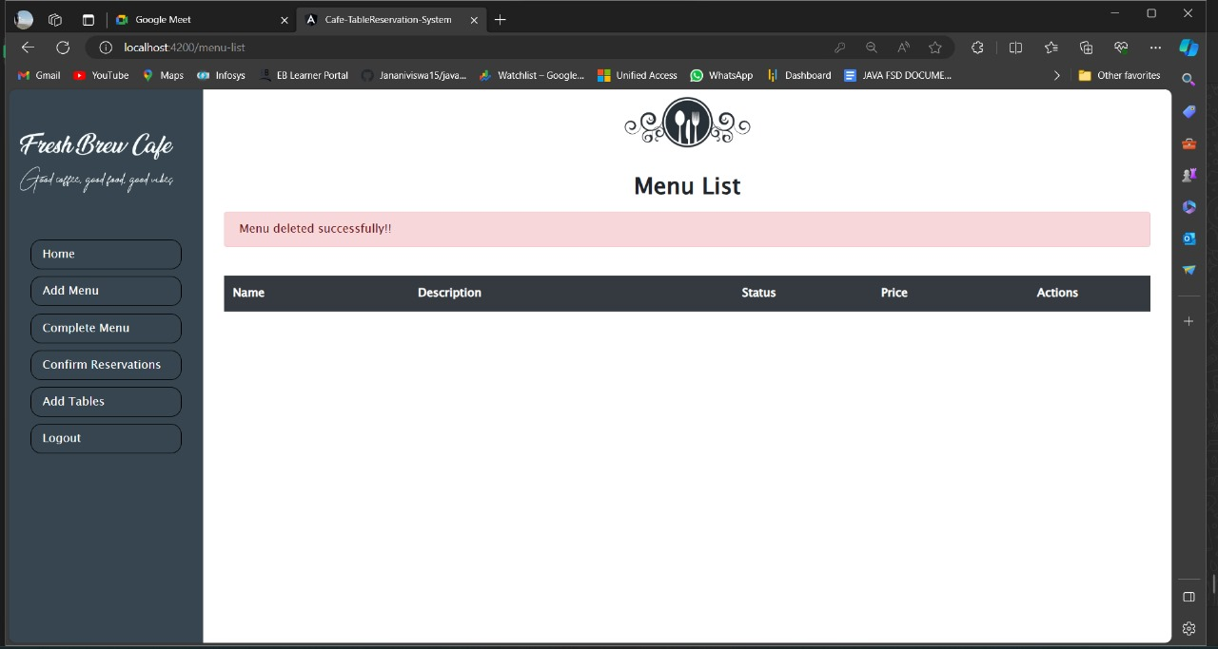
Delete Menu Item
It retrieves the menu item based on the provided name and deletes it.
menu item doesn't exist, it throws an exception.

Slide 26
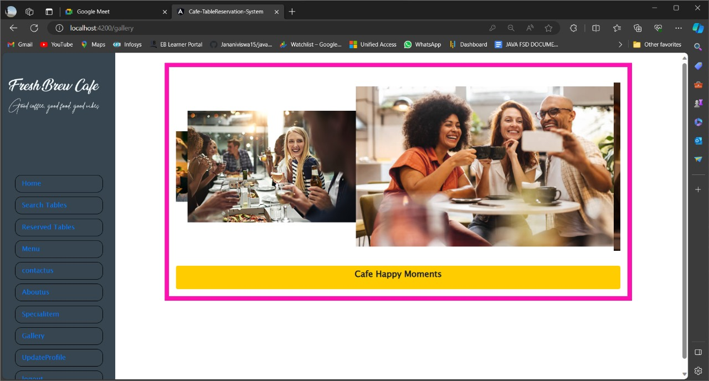
Gallery
Our visual showcase of beautifully set tables and some happy moments.
Explore our gallery for stunning visuals of the cafe ambience and delicious food.

Slide 27
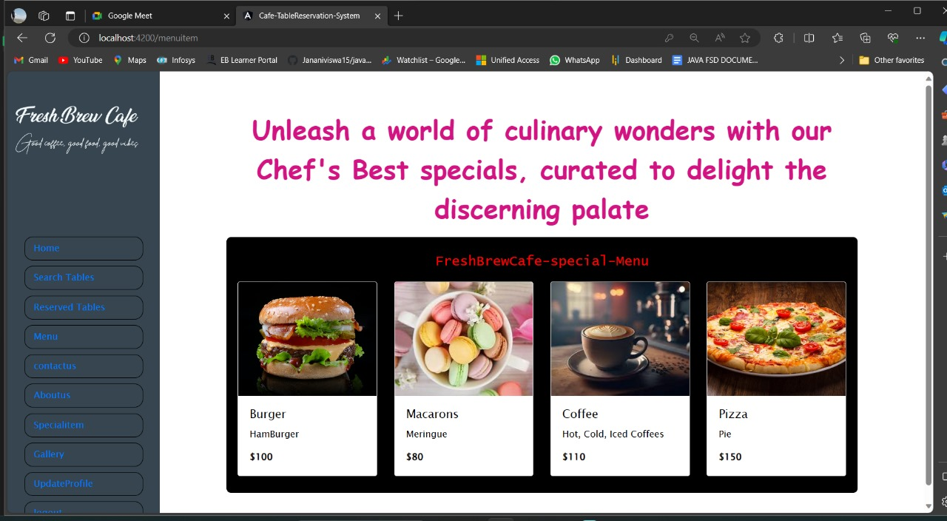
Special Item
Elevate your dining experience with our chefs' best creations
In this Slide User can see different types of special items and there prices which attract the user more towords the café.

Slide 28
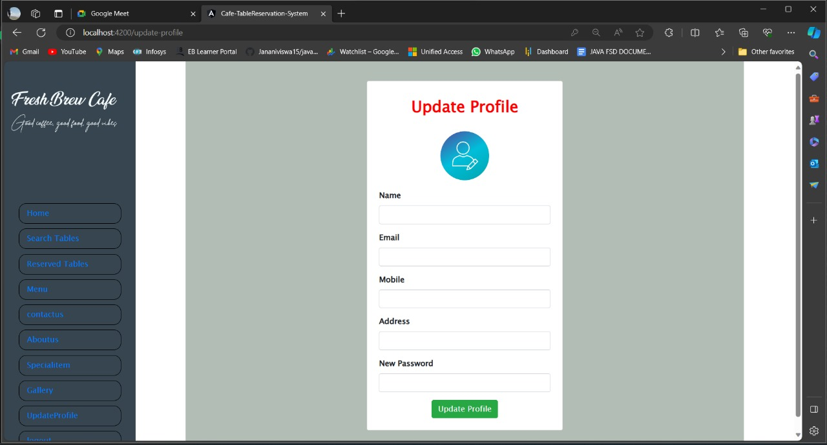
Update Profile
Update Profile helps in updating or editing the user details for his account

Slide 29
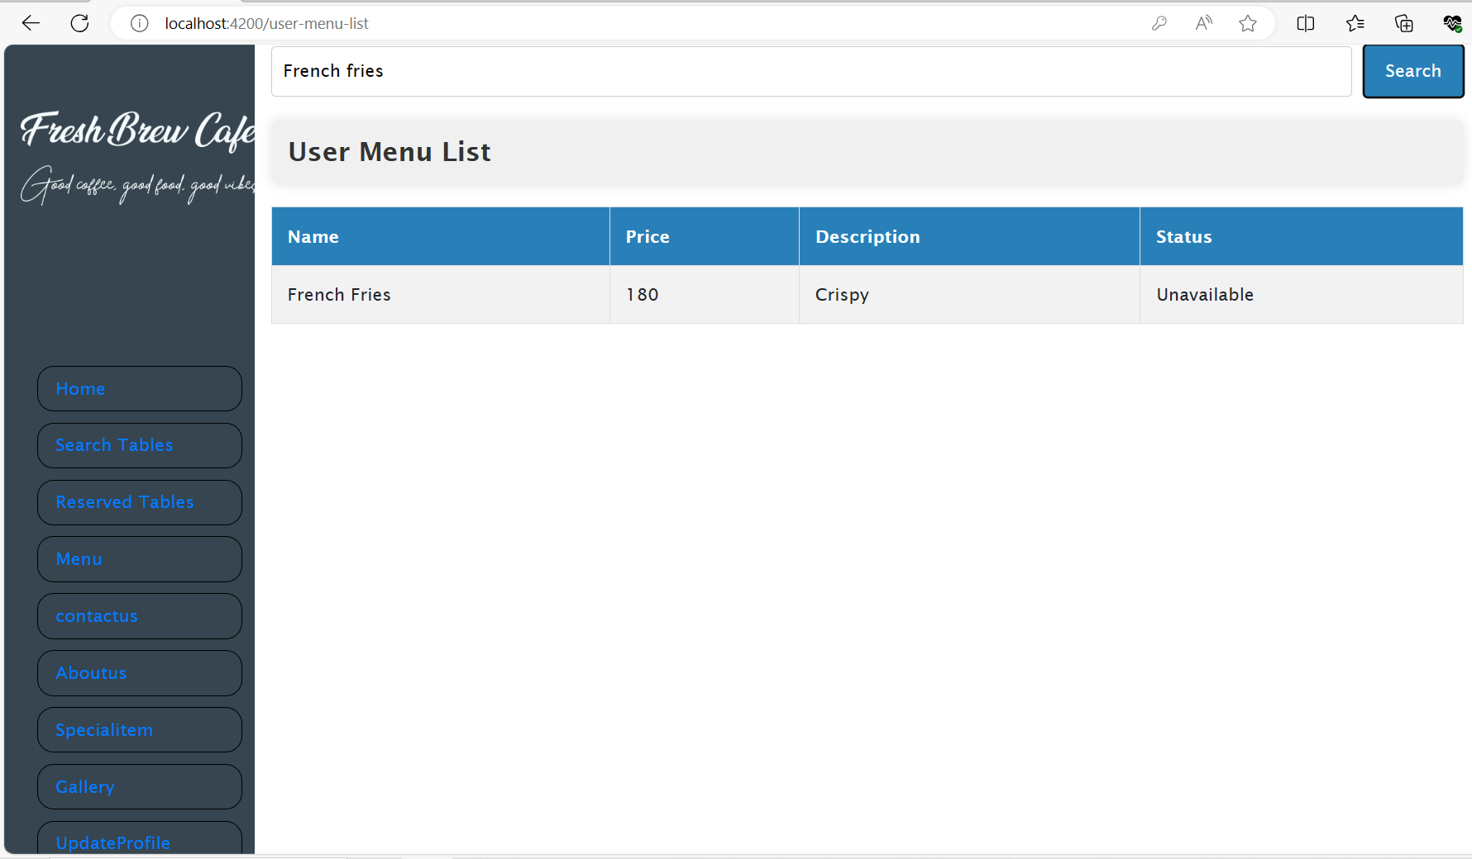
Menu Search Module
The menu's search module improves accessibility, efficiency, and user experience.
Search Functionality: This allows users to search for menu items by their names.
Displayed Information: When the searched item is found in the menu, the system presents the item name, description, price, and availability status .

Slide 30
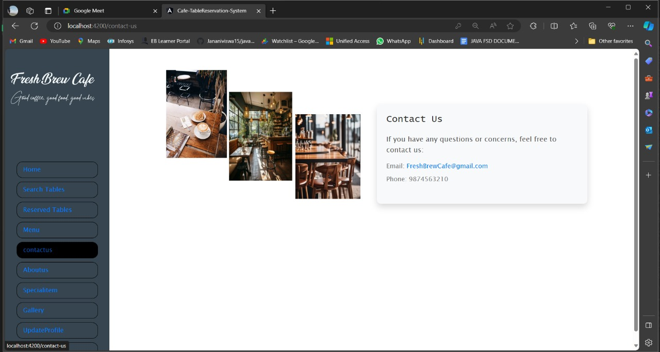
Contact Us
The "Contact Us" feature is a communication channel between customers and the owner, facilitating feedback and inquiries.
We are offering a cafe's email address and phone number for contact

Slide 31
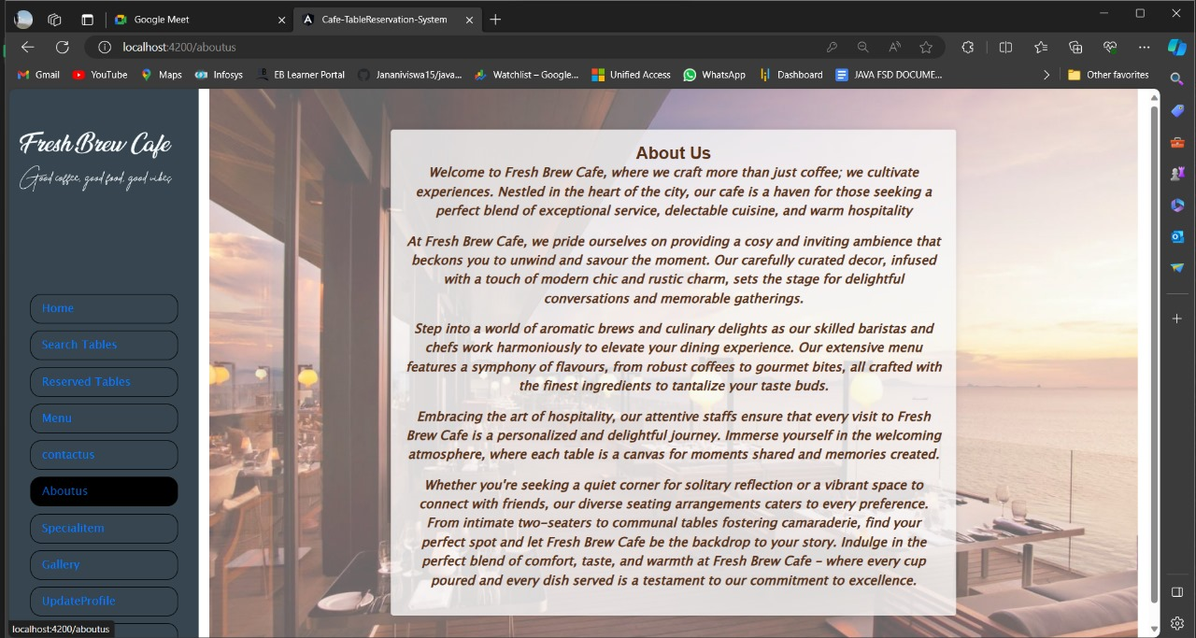
About Us
About Us section plays a important role in creating a positive impression, building trust, and providing valuable information to customers

Slide 32
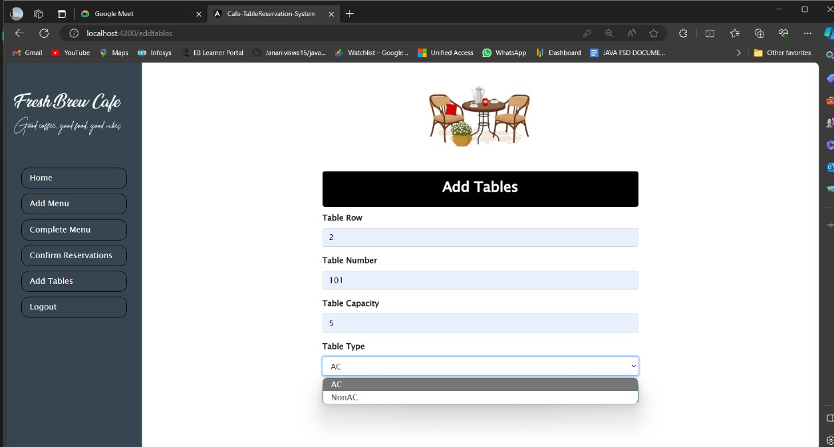
Add Tables
Only admin has the authority to add the table.
The system supports to add the table type(AC & Non AC).
Customer can able to search for the table required.

Slide 33
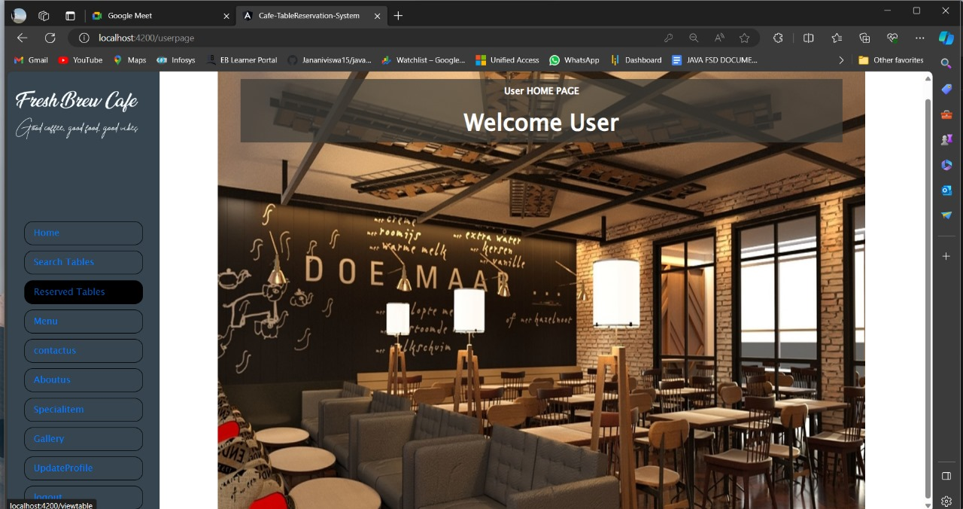
User Dashboard
The authenticated person can login to the portal through their login credentials.
Now the user can access the services provided by the Cafe.
The user can reserve the table as per their requirement.

Slide 34

Testing Reports

Slide 35
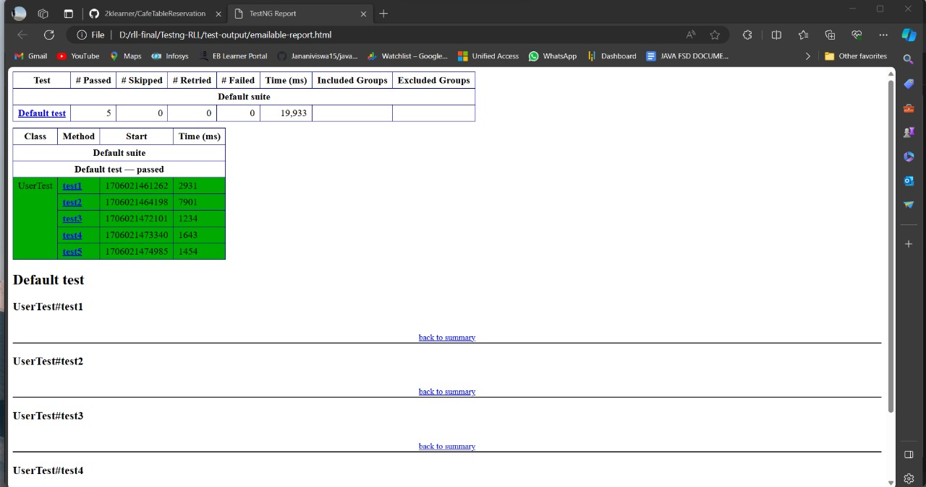
User Test Emailable Report

Slide 36
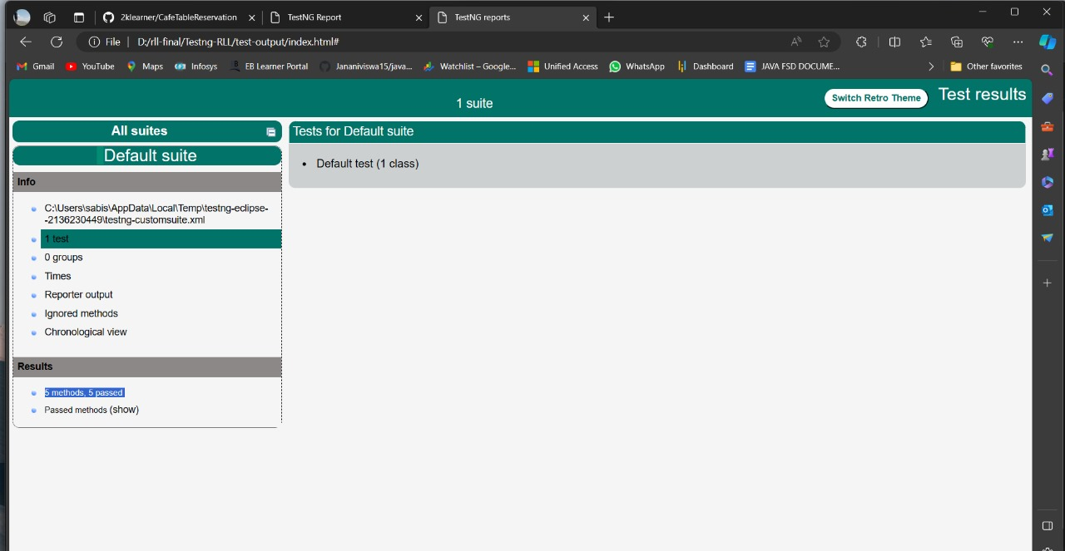
User Test Index

Slide 37
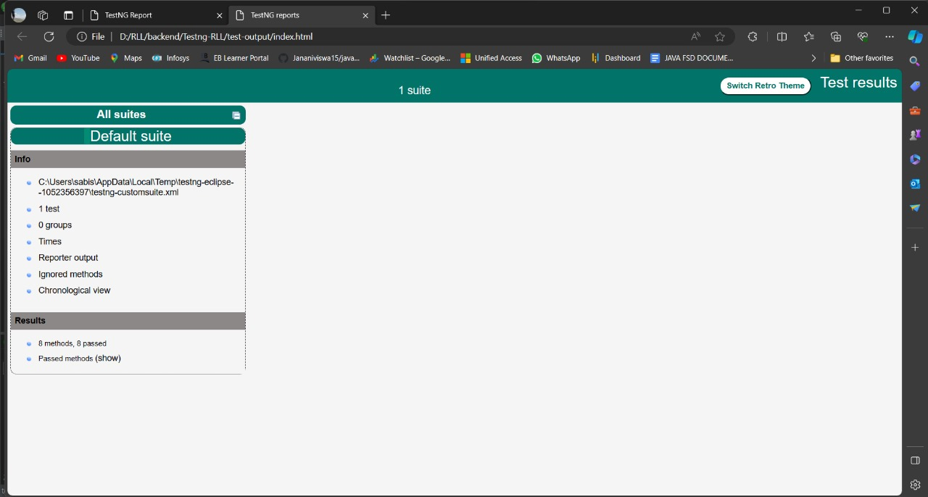
Admin Test Index

Slide 38
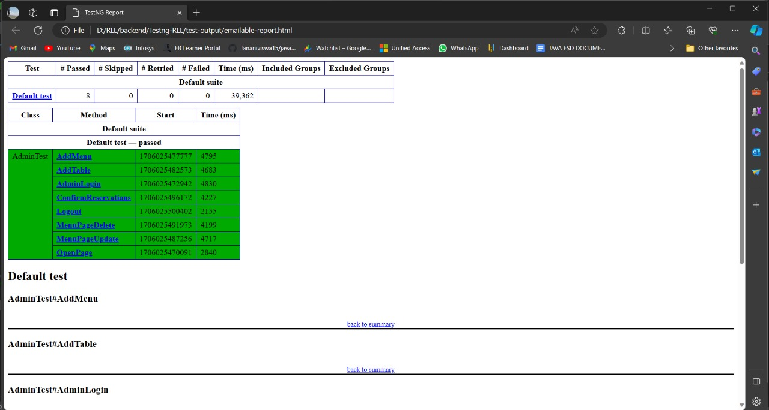
Admin Test Emailable Report

Slide 39

Postman Testing Reports

Slide 40
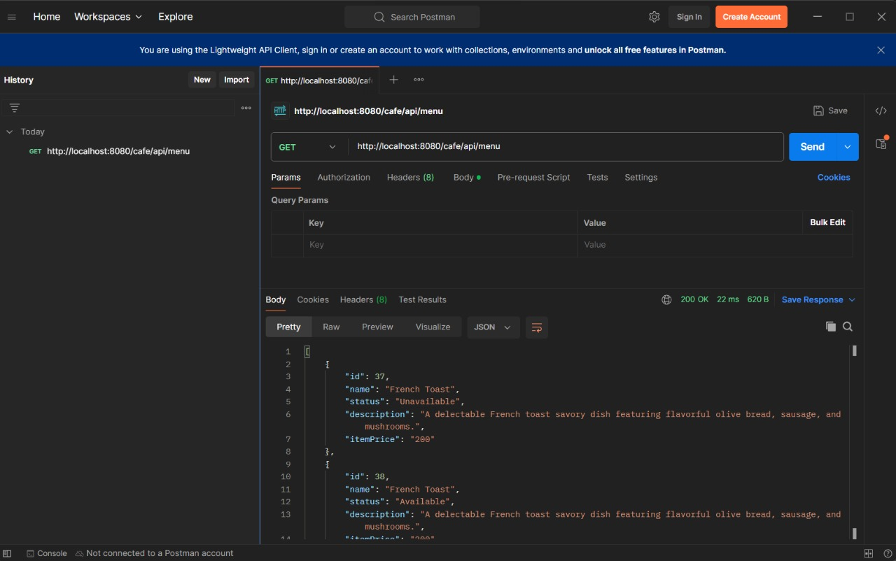
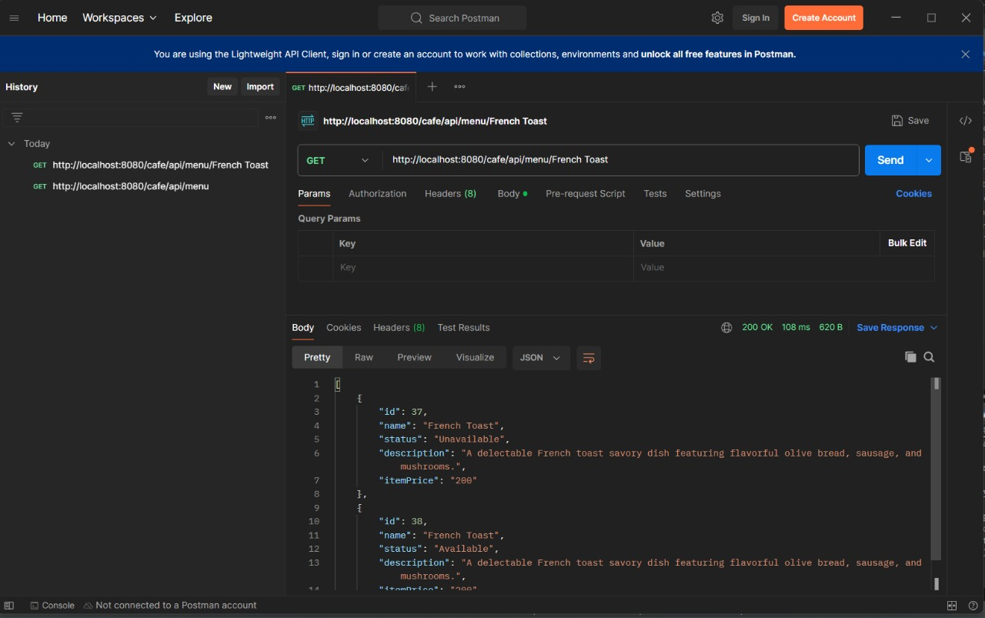
Retrieving All/Retrieving Particular Menu items

Slide 41
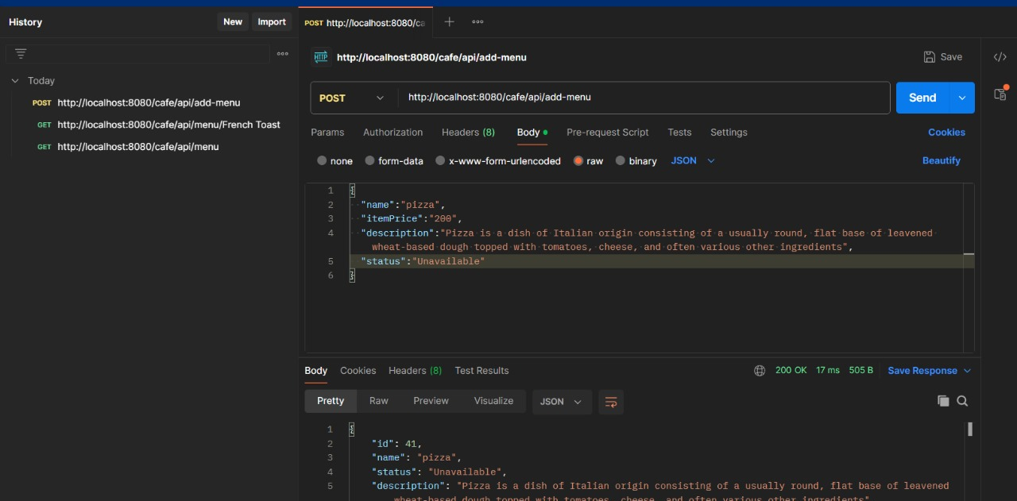
Insert New Items

Slide 42
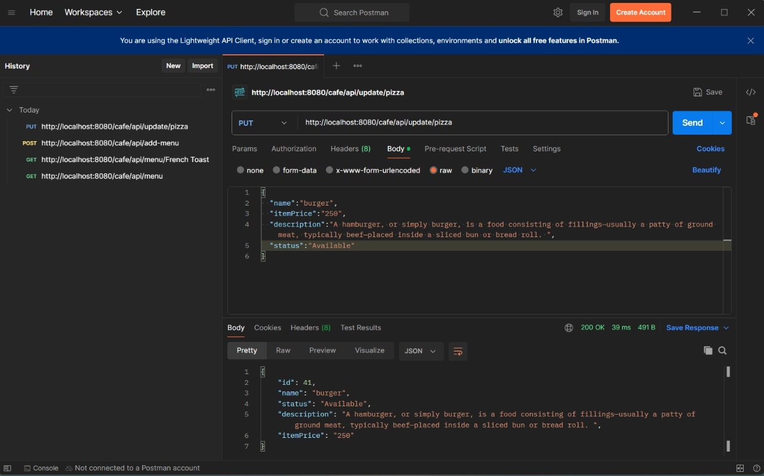
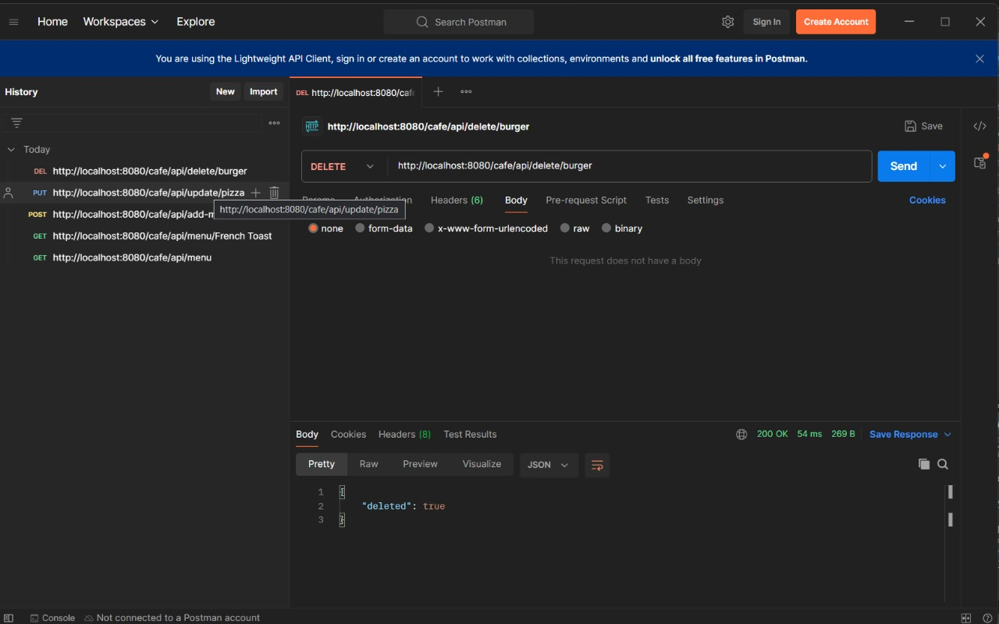
Update/Delete Menu Items

Slide 43
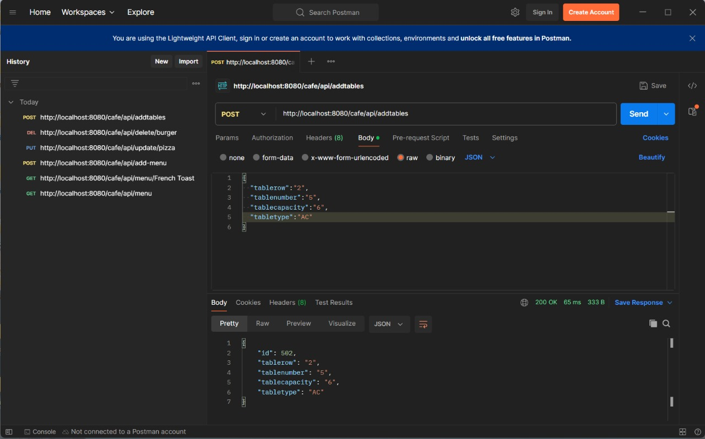
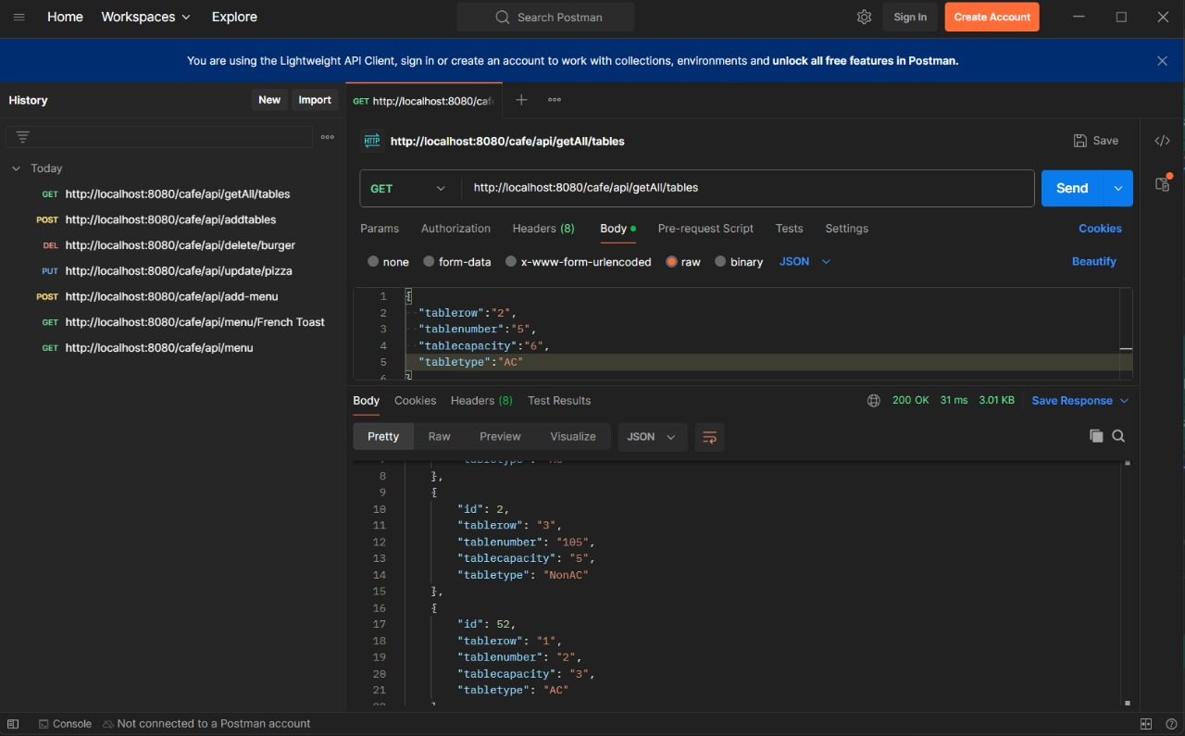
Adding/Retrieve All Tables

Slide 44
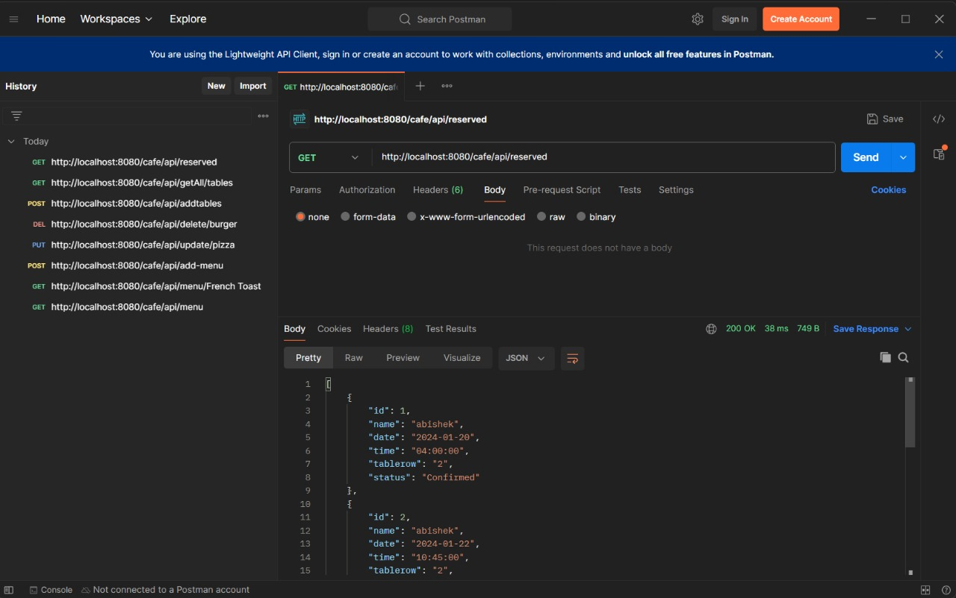
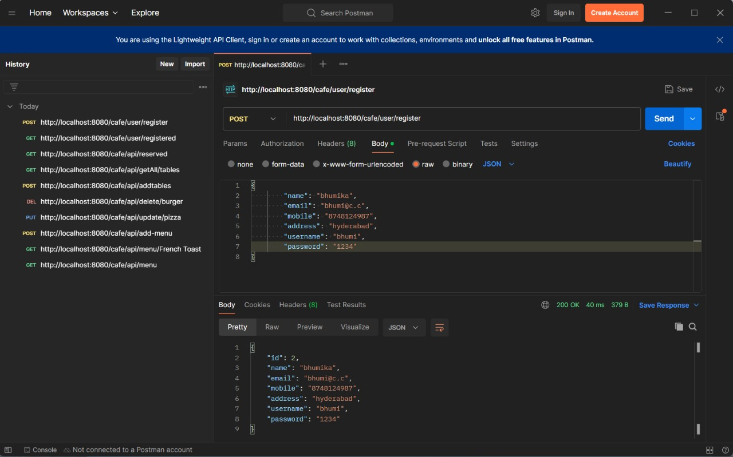
Retrieving Reservation Table/Adding New User

Slide 45
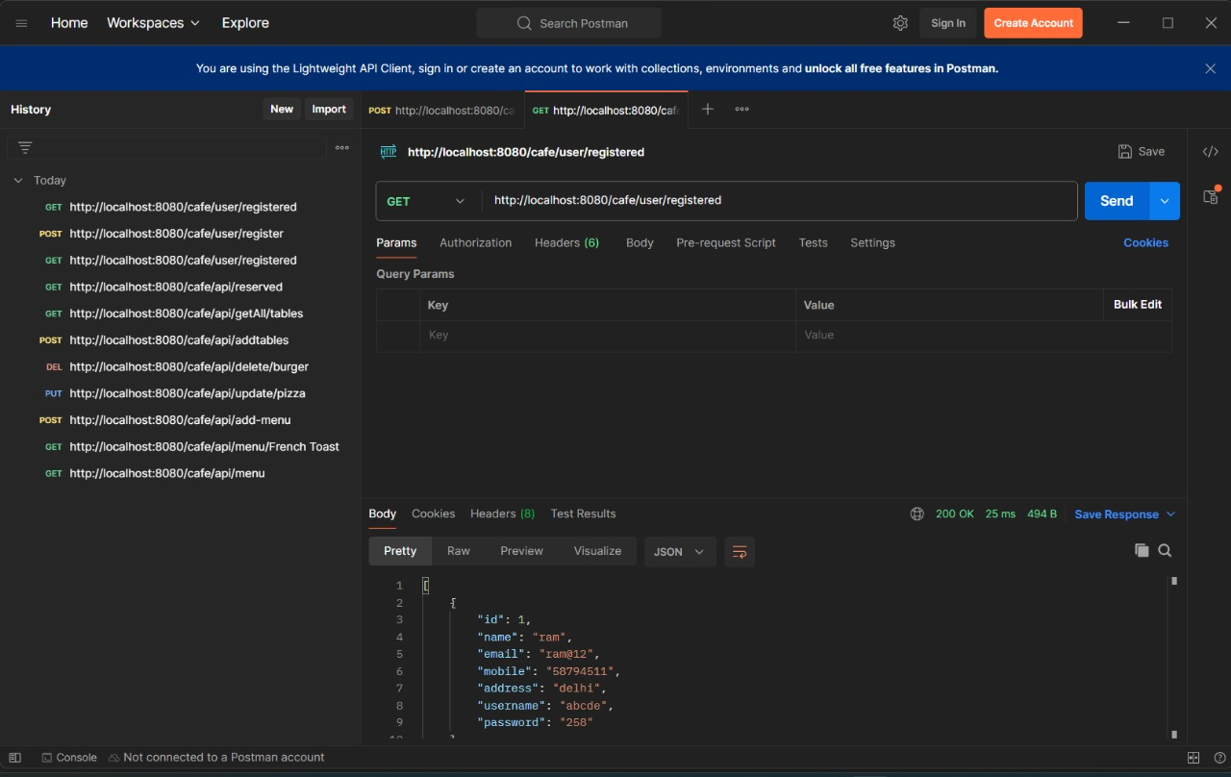
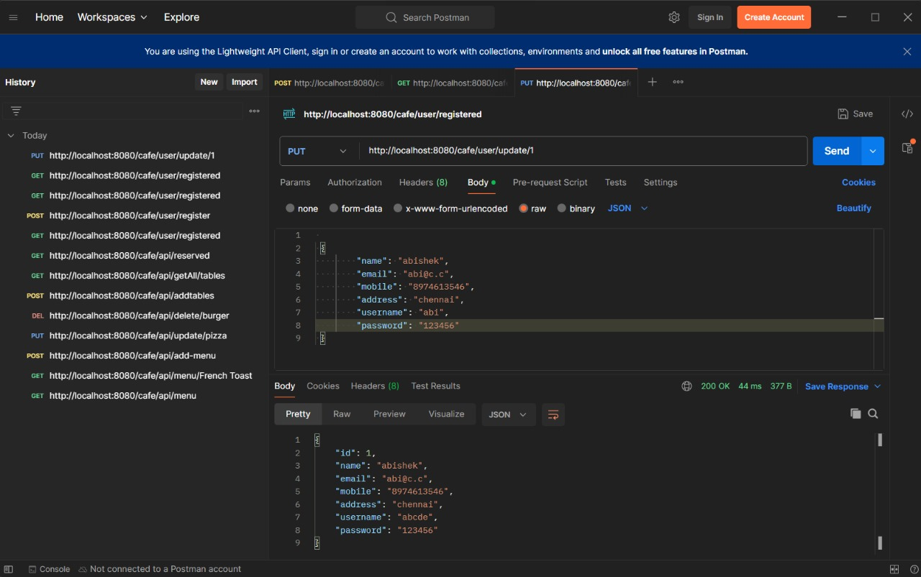
Retrieving Existing User/Update User Details Using Id

Slide 46
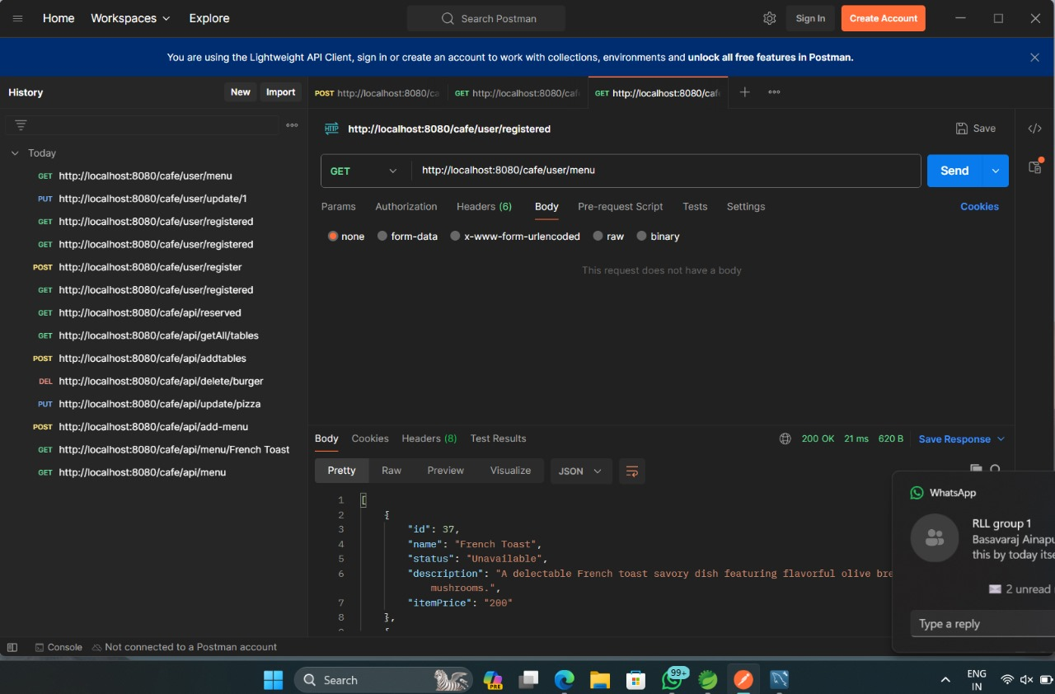
List Of Menu Displayed TO User

Slide 47
CONCLUSION
The Cafe Reservation System, consisting of both the User and Admin sections
Admin section provides a comprehensive solution for managing reservations, menu and enhancing the overall cafe experience.
The User section allows individuals to create personalized accounts, easily manage reservations, and explore the cafe's menu with real-time availability checks.
The intuitive interface ensures a seamless and convenient process for users.

Slide 48
THANK YOU

